Slide 1
Zomato Restaurant Clustering & Sentiment Analysis
by Debanjan Ganguly
Data Science Trainee
AlmaBetter, Bengaluru

Slide 2
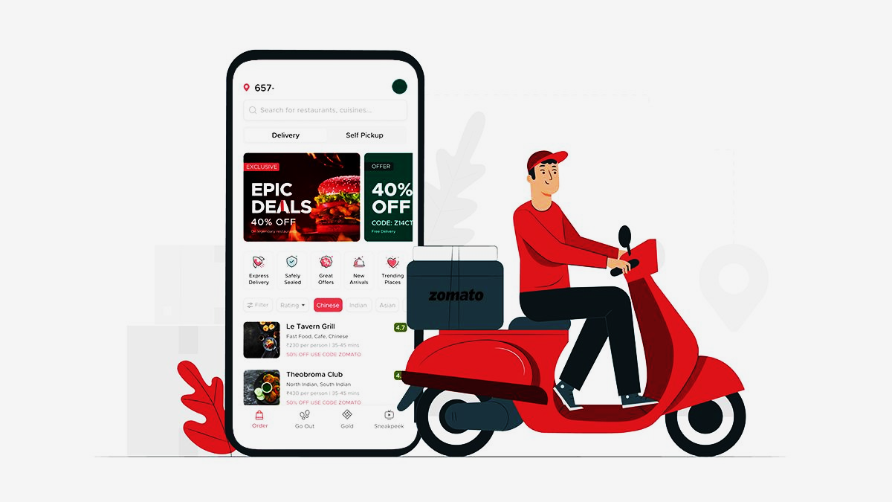
Introduction
Zomato is an Indian restaurant aggregator and food delivery start-up founded by Deepinder Goyal and Pankaj Chaddah in 2008. Zomato provides information, menus and user-reviews of restaurants, and also has food delivery options from partner restaurants in select cities.
India is quite famous for its diverse multi cuisine available in a large number of restaurants and hotel resorts, which is reminiscent of unity in diversity. Restaurant business in India is always evolving. More Indians are warming up to the idea of eating restaurant food whether by dining outside or getting food delivered. The growing number of restaurants in every state of India has been a motivation to inspect the data to get some insights, interesting facts and figures about the Indian food industry in each city. So, this project focuses on analyzing the Zomato restaurant data for each city in India. Starting with EDA we’ve focused on clustering restaurants by cost, ratings and cuisines served. We’ve analyzed the reviews given and performed sentiment analysis and topic modelling too.

Slide 3
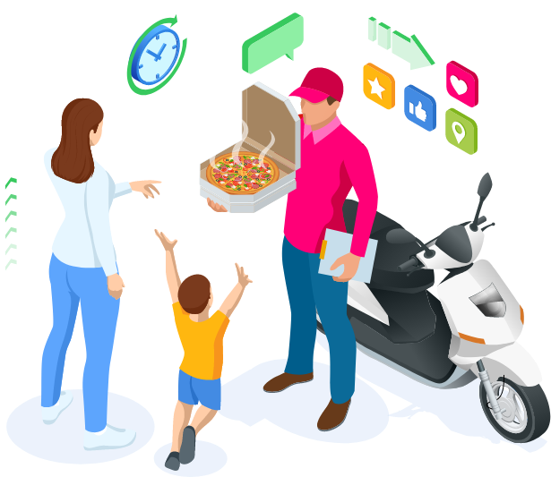
Problem Statement & Approach
The Project focuses on Customers and Company, we will analyze the sentiments of the reviews given by the customer in the data and made some useful conclusion in the form of Visualizations. Also, cluster the Zomato restaurants into different segments. The data is visualized as it becomes easy to analyze data at instant. The Analysis also solve some of the business cases that can directly help the customers finding the best restaurant in their locality and for the company to grow up and work on the fields they are currently lagging in.
We’ve two datasets available for analysis, one contains over 100 restaurant information like cost, timing, served menus etc. The other one contains ten thousands reviews of users .
Data Preparation
Clustering
Text Preparation
Topic Modelling
Sentiment Analysis
EDA

Slide 4
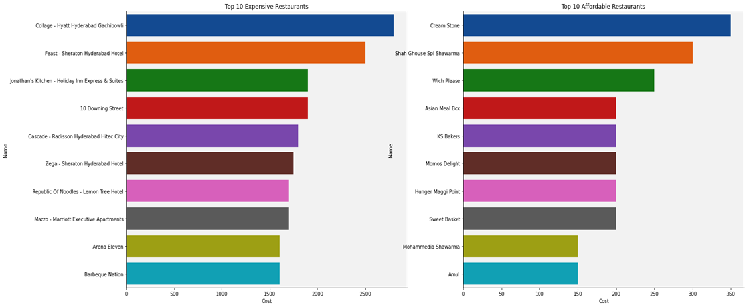
Exploratory Data Analysis
1
Top 10 Most Expensive and Affordable Restaurants

Slide 5
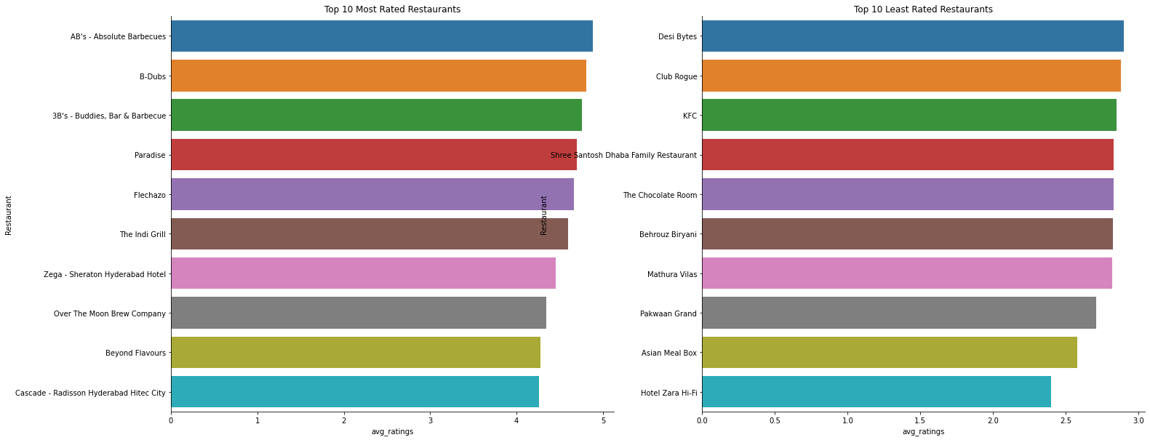
Exploratory Data Analysis
2
Top 10 Most and Least Rated Restaurants

Slide 6
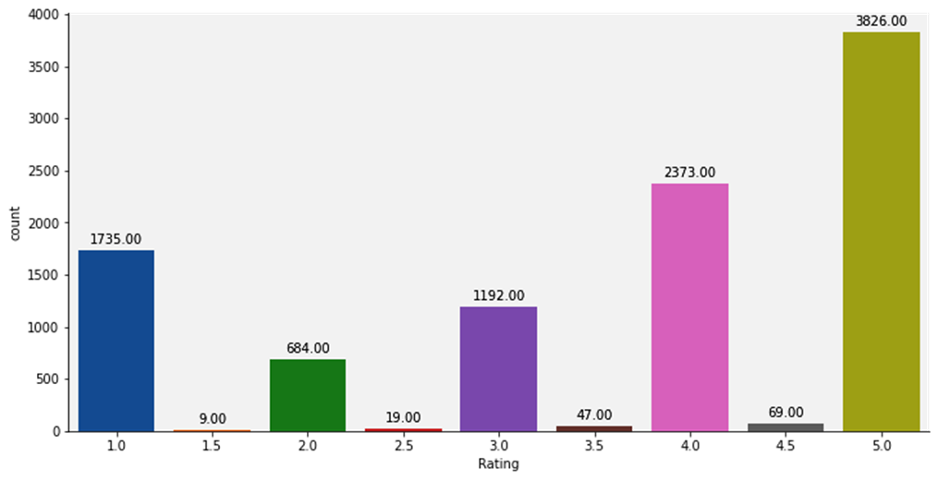
Exploratory Data Analysis
38% reviews are 5 rated,23% are 4 rated stating that people do rate good food high. 17% ratings are 1 star. Also people tends to rate in a full definite manner, they choose 4 or 5 over 4.5
3
Count Distribution of Ratings

Slide 7
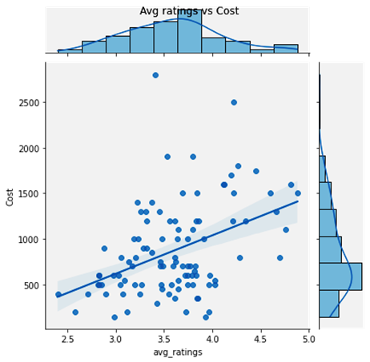
Exploratory Data Analysis
Though a clear linear relationship can not be observed, but normally we can see some dense grouped low budget restaurants with low avg ratings.
4
Avg Ratings vs Cost

Slide 8
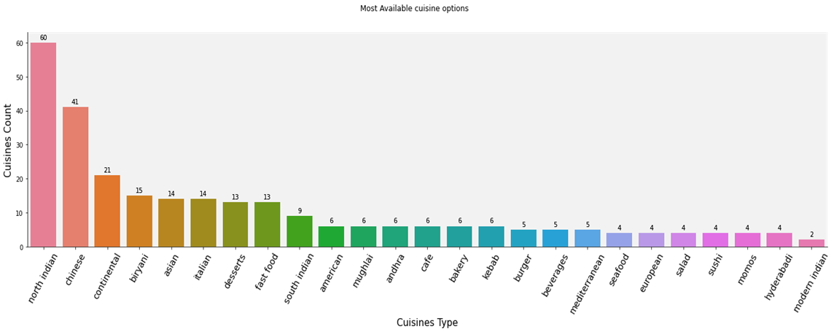
Exploratory Data Analysis
5
Most Available Cuisines Option

Slide 9
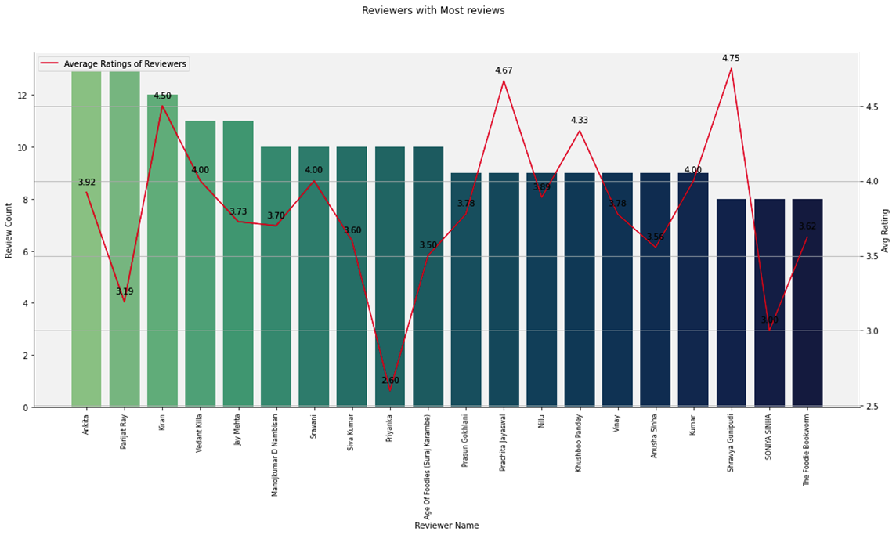
Exploratory Data Analysis
6
Reviewers with Most reviews and Avg Ratings

Slide 10
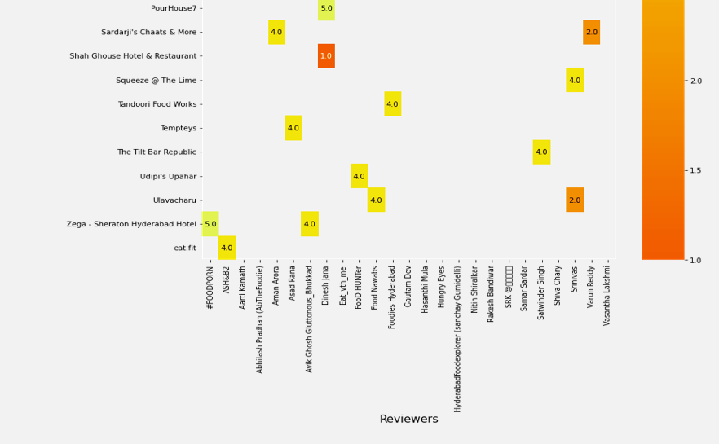
Exploratory Data Analysis
7
Ratings of the Restaurants by the Top Reviewers

Slide 11
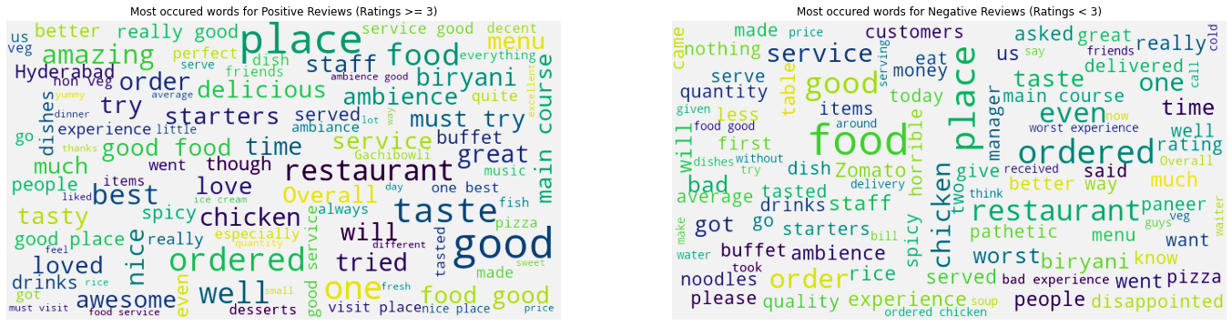
Exploratory Data Analysis
8
Most Frequent words in Positive and Negative Reviews

Slide 12
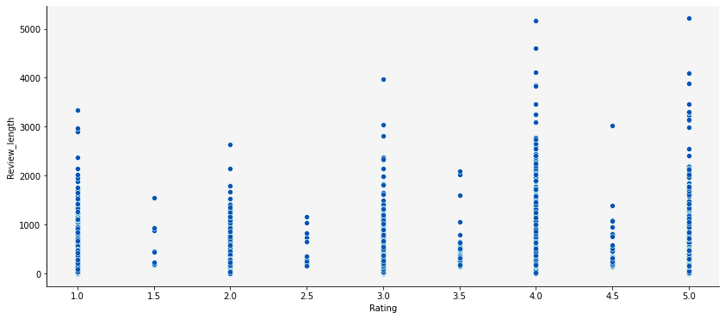
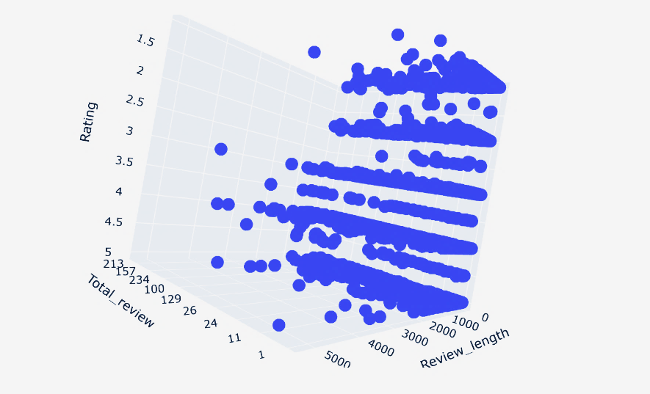
Exploratory Data Analysis
9
Review Length vs Rating vs Number of Reviews

Slide 13
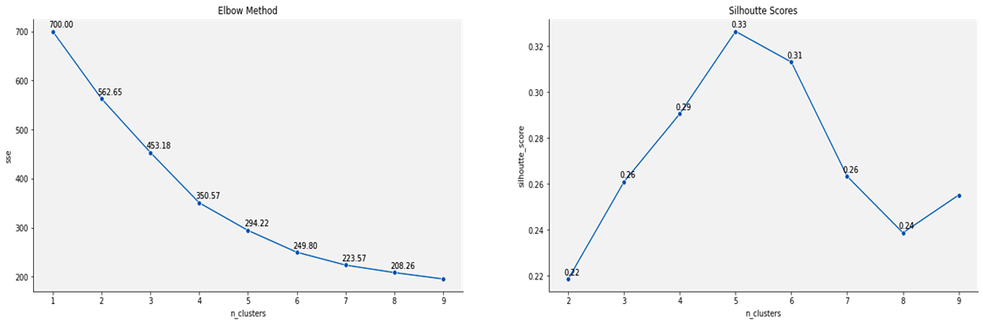
Restaurant Clustering (KMeans)
1
Kmeans Clustering : Finding best number of clusters through Elbow method and Silhouette Analysis

Slide 14
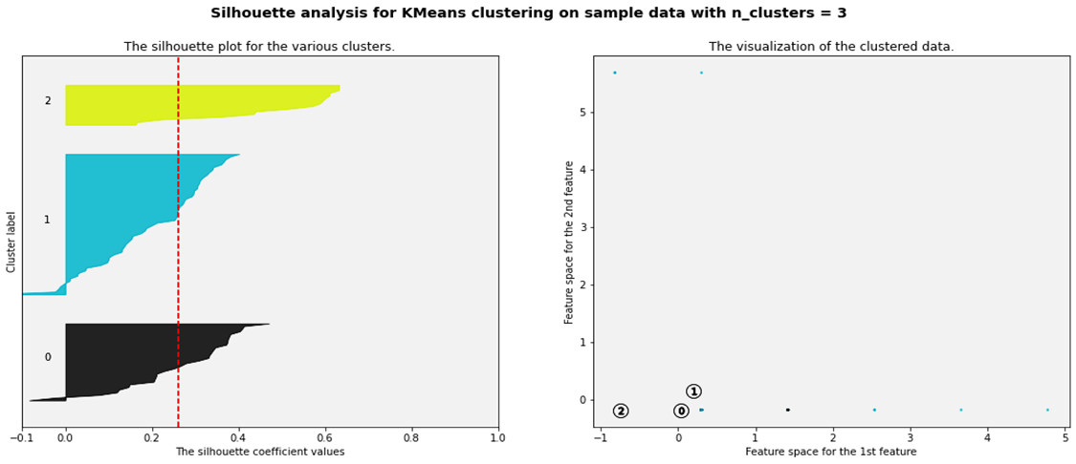
Restaurant Clustering (KMeans)
2
Silhouette Analysis for Kmeans Clustering with n_clusters = 3, average silhouette score is : 0.260951107

Slide 15
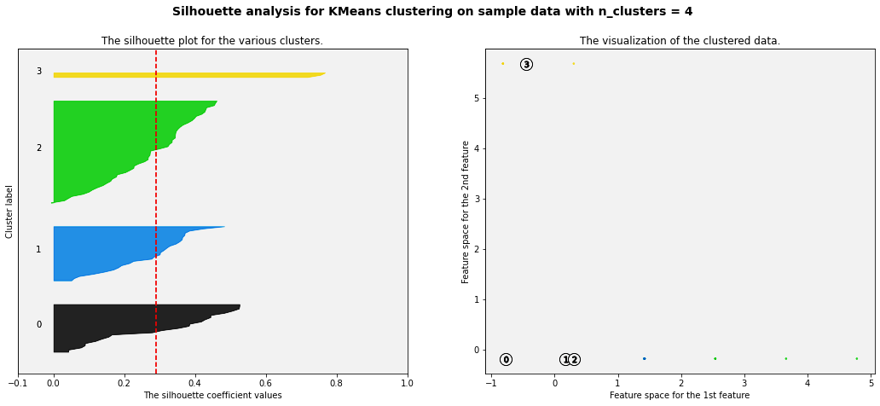
Restaurant Clustering (KMeans)
3
Silhouette Analysis for Kmeans Clustering with n_clusters = 4, average silhouette score is : 0.290576127

Slide 16
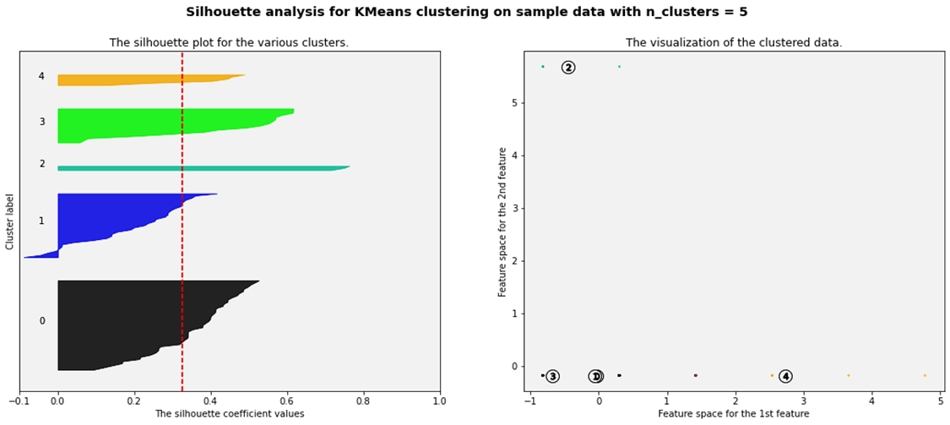
Restaurant Clustering (KMeans)
4
Silhouette Analysis for Kmeans Clustering with n_clusters = 5, average silhouette score is : 0.3265044204

Slide 17
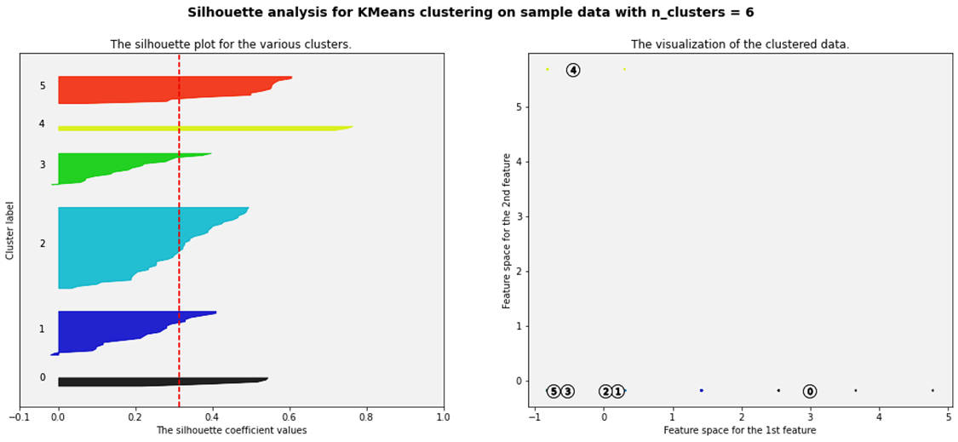
Restaurant Clustering (KMeans)
5
Silhouette Analysis for Kmeans Clustering with n_clusters = 6, average silhouette score is : 0.3131077512

Slide 18
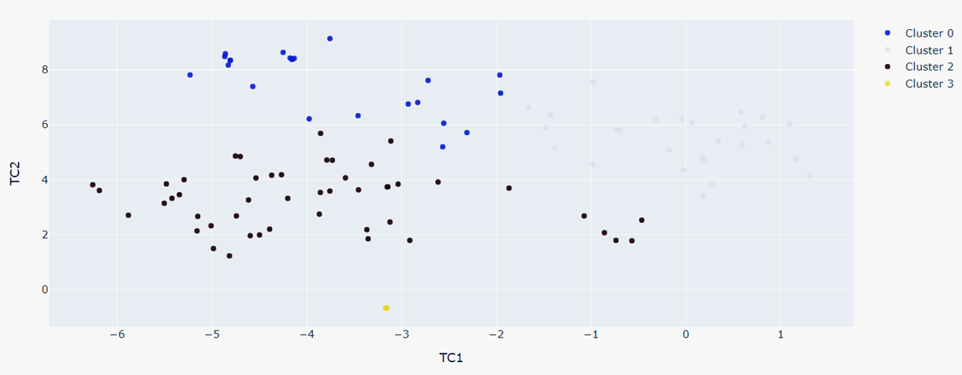
Restaurant Clustering (KMeans)
6
Visualizing clusters in 2d using t-SNE (perplexity = 40)

Slide 19
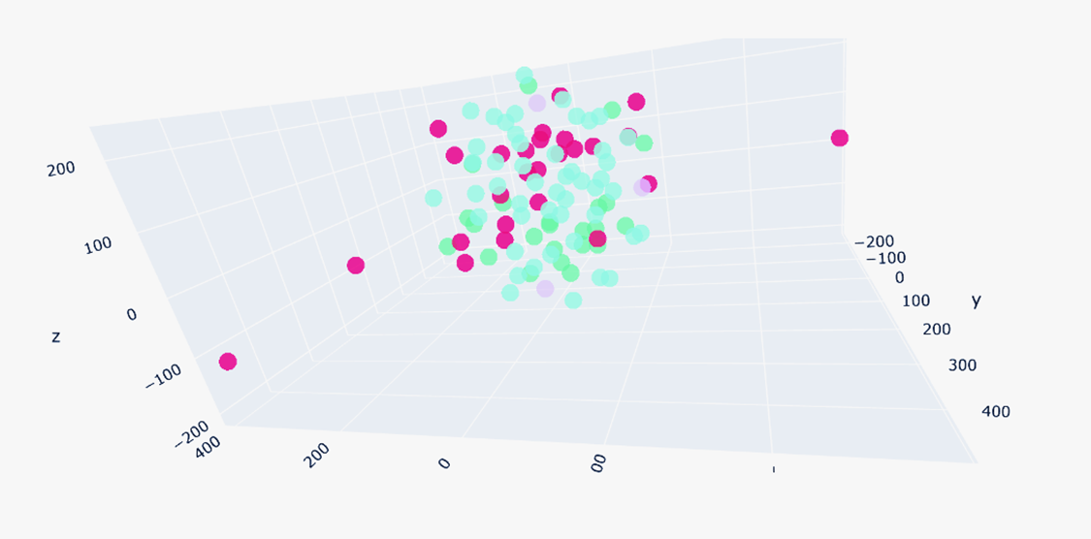
Restaurant Clustering (KMeans)
7
Visualizing clusters in 3d using t-SNE (perplexity = 40)

Slide 20
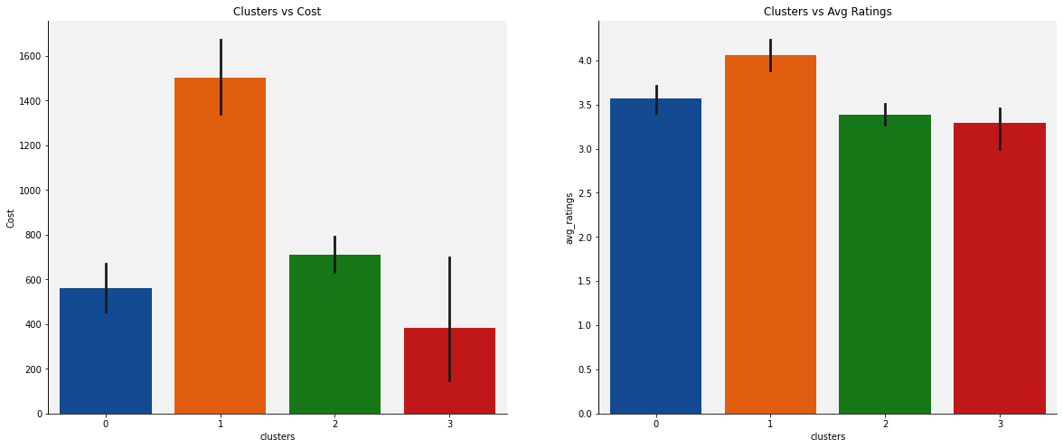
Restaurant Clustering (KMeans)
8
From Silhouette Analysis, we can identify n_clusters = 4 as optimum number of cluster

Slide 21
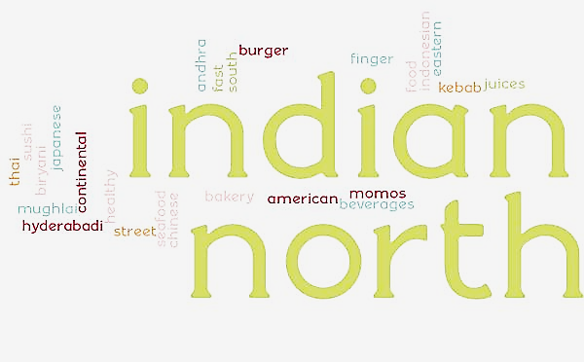
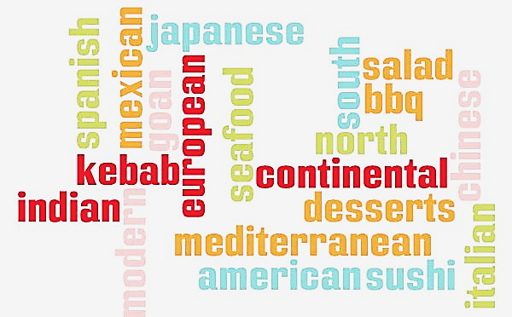
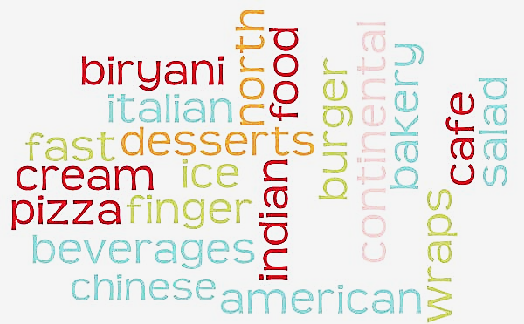

Restaurant Clustering (KMeans)
9
Visualizing clusters against cuisines served

Slide 22
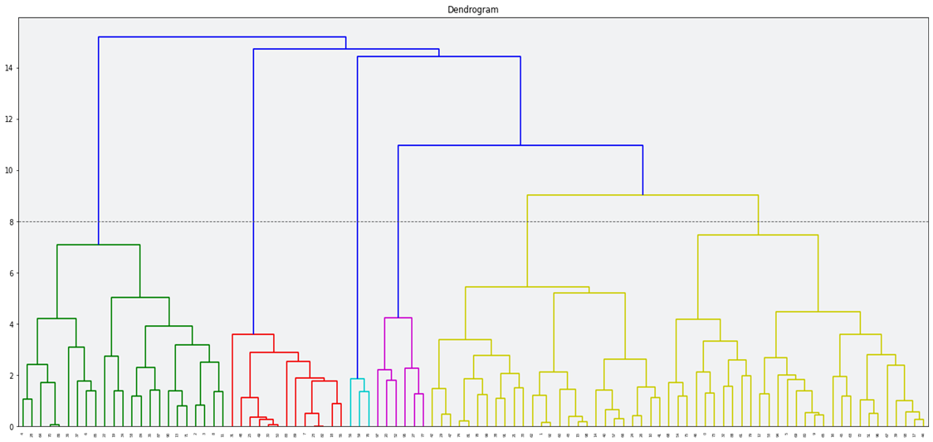
Restaurant Clustering (Agglomerative Clustering)
1
Dendrogram with Horizontal Threshold Line, 6 vertical lines cross the threshold ; optimal n_clusters = 6

Slide 23
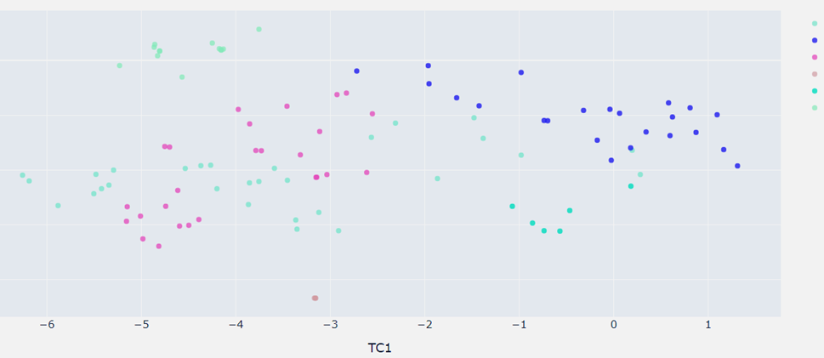
Restaurant Clustering (Agglomerative Clustering)
2
Visualizing hierarchical clusters in 2d using t-SNE (perplexity = 40)

Slide 24
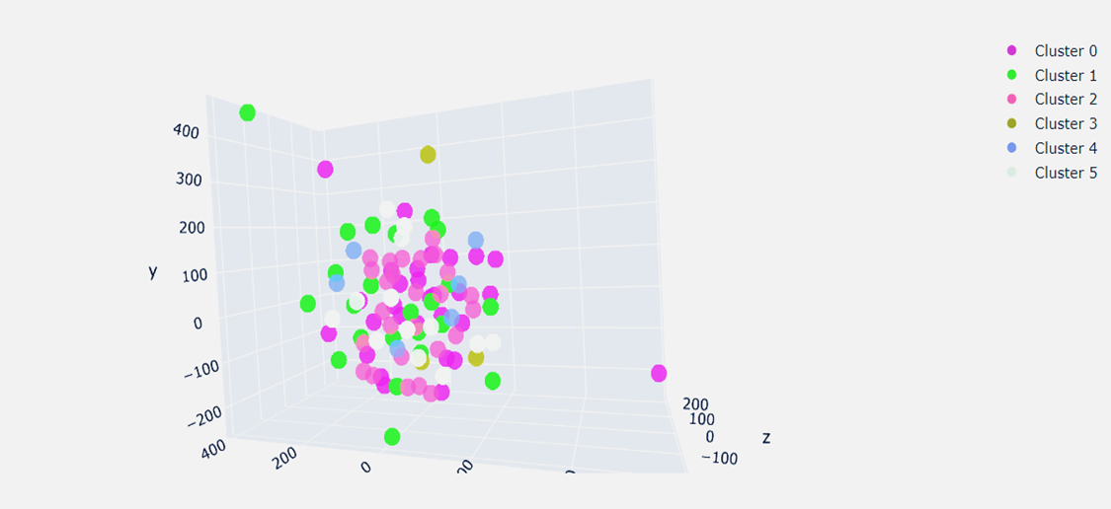
Restaurant Clustering (Agglomerative Clustering)
3
Visualizing hierarchical clusters in 3d using t-SNE (perplexity = 40)

Slide 25
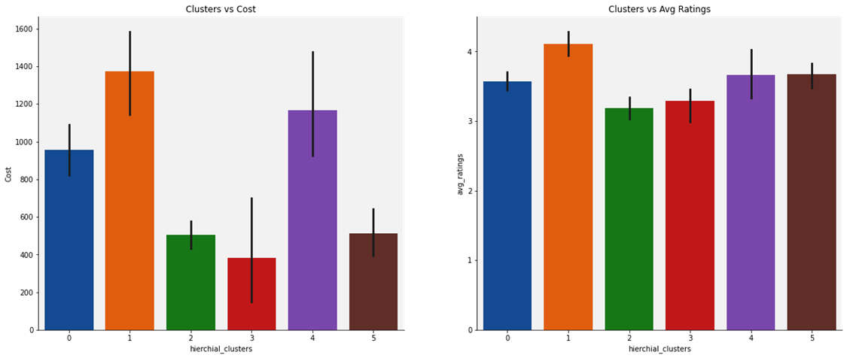
Restaurant Clustering (Agglomerative Clustering)
4
Cost and Avg rating against Hierarchical Clusters

Slide 26
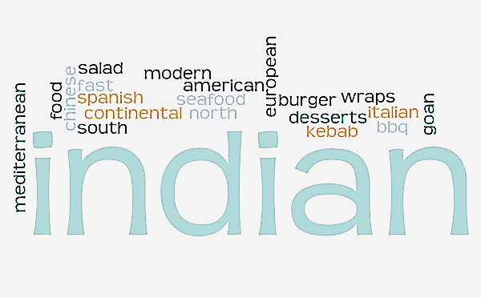
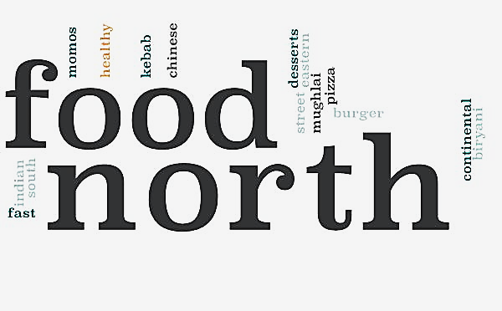
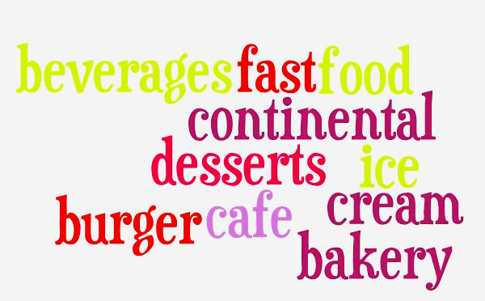

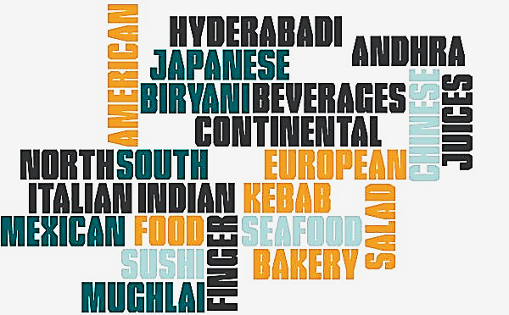
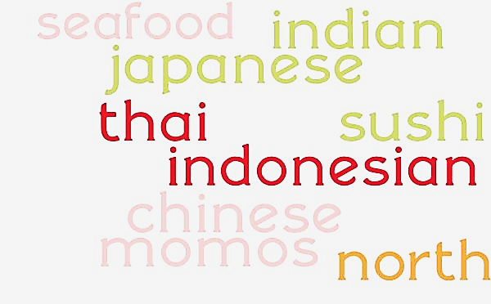
Restaurant Clustering (Agglomerative Clustering)
5
Visualizing clusters against cuisines served

Slide 27
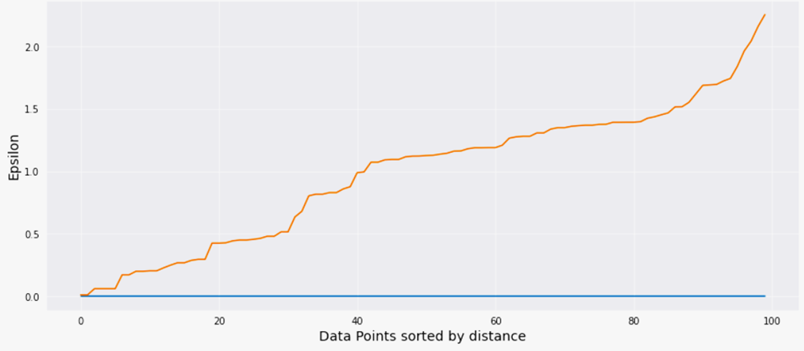
Restaurant Clustering (DBScan)
1
Hyper parameter Tuning
DBSCAN stands for Density-Based Spatial Clustering
DBSCAN requires only two parameters: epsilon and minPoints. Epsilon is the radius of the circle to be created around each data point to check the density and minPoints is the minimum number of data points required inside that circle for that data point to be classified as a Core point.
The process to extract hyper parameters are below:
1
minPoints
Normally, in case of dimension greater than 2, min samples should be 2*Dimensions
2
epsilon
To obtain epsilon, we will perform KNearestNeighbors with k = 2 ;
We need the distance between a point and its nearest data point for all data points in the dataset. We will plot it, The optimum value of epsilon is at the point of maximum curvature in the K-Distance Graph. By looking at the curve visually, it looks like maximum curvature of the curve is about 1.75. So we took epsilon as 1.75

Slide 28
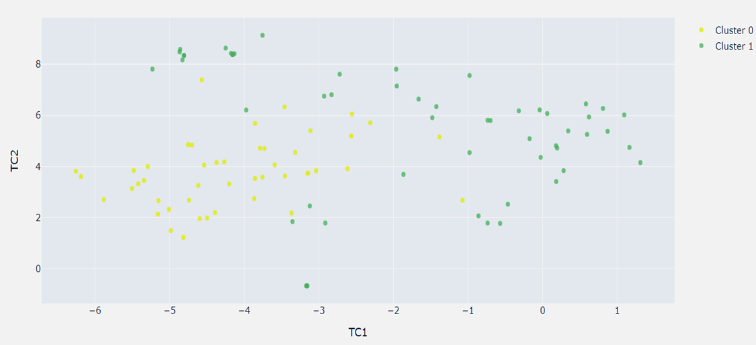
Restaurant Clustering (DBScan)
2
Visualizing Density-based Clusters in 2d using t-SNE (perplexity = 40)

Slide 29
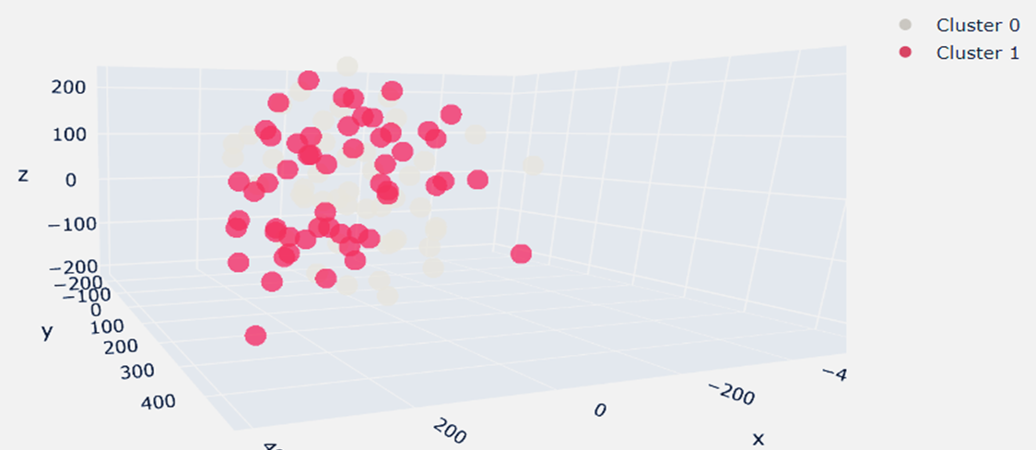
Restaurant Clustering (DBScan)
3
Visualizing Density-based Clusters in 3d using t-SNE (perplexity = 30)

Slide 30
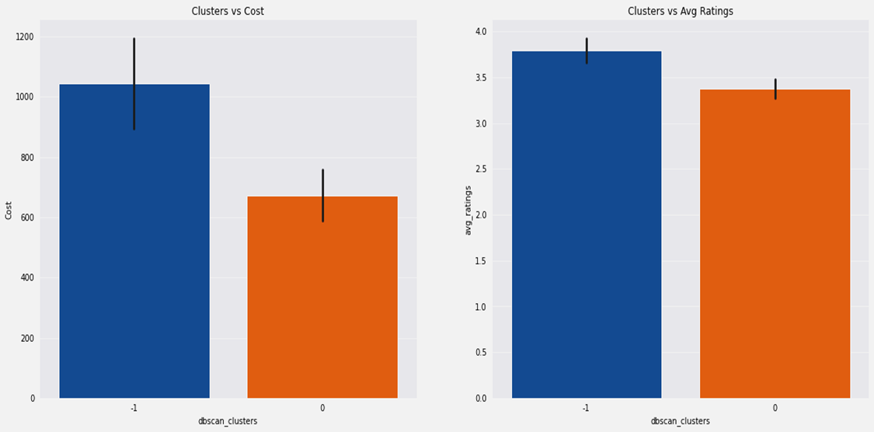
Restaurant Clustering (DBScan)
4
Cost and Avg rating against Density-based Clusters

Slide 31
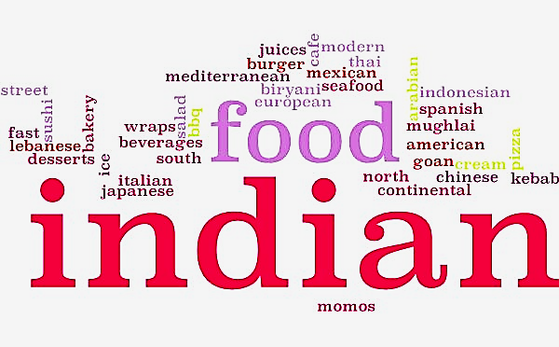
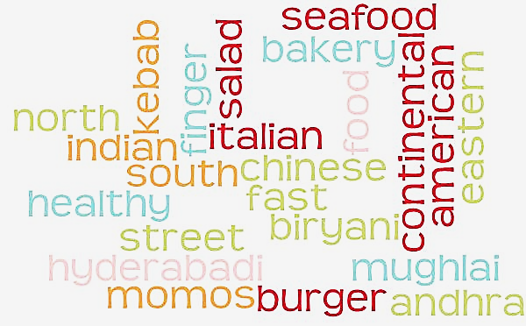
Restaurant Clustering (DBScan)
5
Visualizing clusters against cuisines served

Slide 32
Data Preparation (way to Topic Modelling & Sentiment Analysis)
1
Text Preprocessing
Machine Learning needs data in numeric form. So, we vectorize texts using BOW, tf-idf, Word2vec etc. But before vectorization, raw text is required to be cleaned first.
Text Processing means to bring the raw text to a more predictable and analyzable form.
This process is called Tokenization. It split the sequence of strings into words. It removes all the punctuations from the text data and gives words of text which is called tokens. It also converts alphabets to lower case.
This is Regular Expression Based Processing. Any url links is also replaced with word “url”.
Any 3 consecutive letters have been replaced with 2 letters of the same alphabet. For ex, heyyyy is replaced to heyy.
Tokens are filtered by their word length. Any word with length less than 3 has been removed from corpus.
This process removes stop words i.e. which does not play any important in giving intelligent pattern or information from the document. Ex: the words like “as”, “by”, “are”, “then”, “with” etc.

Slide 33
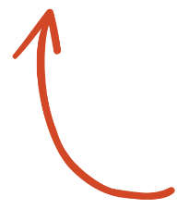
Data Preparation (way to Topic Modelling & Sentiment Analysis)
1
Text Normalization
Text normalization is a pre-processing step aimed at improving the quality of the text and making it suitable for machines to process. This helps us to reduce the amount of different information that the computer has to deal with, and therefore improves efficiency.
The goal of normalization techniques like stemming and lemmatization is to reduce inflectional forms and sometimes derivationally related forms of a word to a common base form.
Stemming is the process of reducing a word to its stem or root format. Let us take an example. Consider three words, “branched”, “branching” and “branches”, root of these 3 words is “branch”
In lemmatization, the transformation uses a dictionary to map different variants of a word back to its root format. Non trivial inflections such as “is”, “was”, “were” is transformed to the root “be”
We’ve Selected this

Slide 34
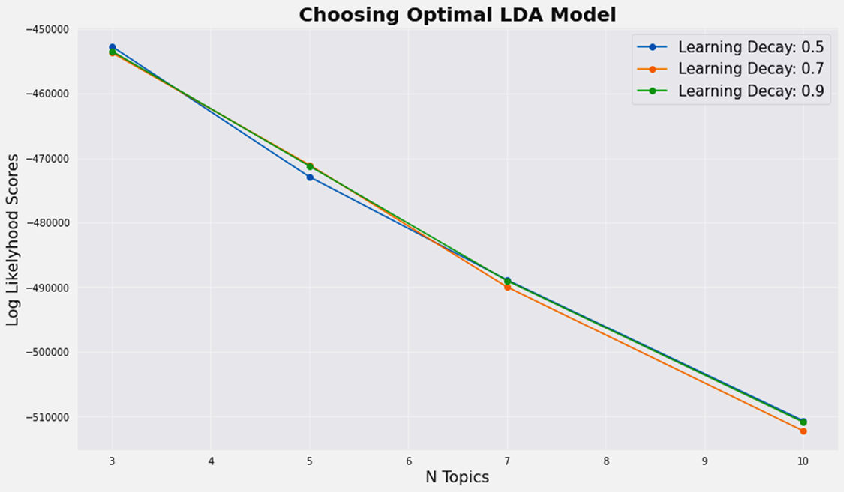
Topic Modelling
1
Introduction & Metrics Obtained
LDA is a popular topic modeling technique to extract topics from a given corpus. The term latent conveys something that exists but is not yet developed. In other words, latent means hidden or concealed. Now, the topics that we want to extract from the data are also “hidden topics”. It is yet to be discovered. Hence, the term “latent” in LDA. The Dirichlet allocation is after the Dirichlet distribution and process.
2 different models have been trained :
1
Steps involved are Vectorization (CountVectorizer) → LDA
Log Likelihood Score : -1984697.3822986 (the more the better)
Model Perplexity : 1861.9365422499502 (the less the better)
2
Steps involved are Vectorization (CountVectorizer) → 3 Fold Cross Validation (ShuffleSplit → Grid Search)
Log Likelihood Score : -452717.07873869175 (the more the better)
Model Perplexity : 1797.1764277422712 (the less the better)
Best Hyperparameter Obtained : learning_decay 0.5
n_components 3

Slide 35
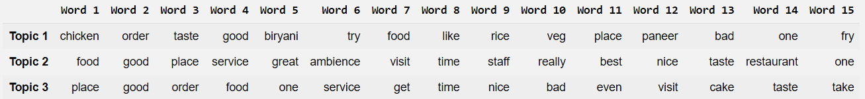
Topic Modelling
2
Top 15 words in every topic

Slide 36
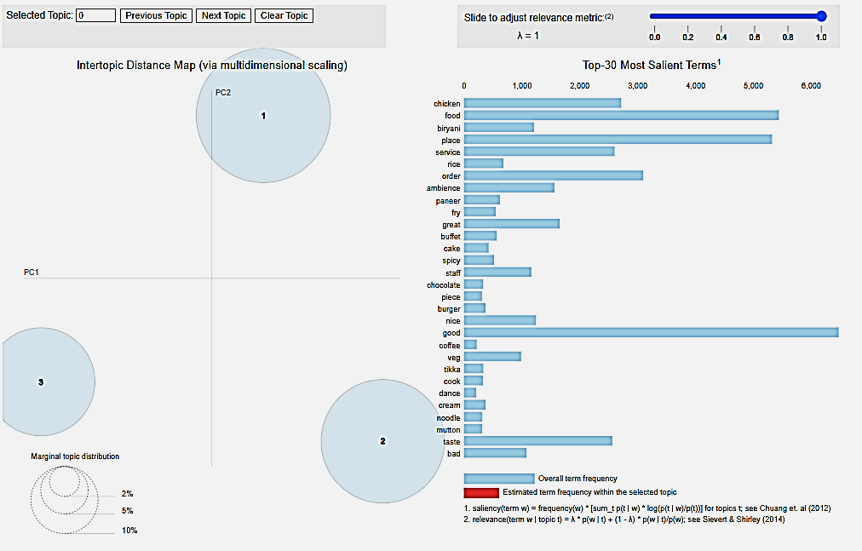
Topic Modelling
3
Intertopic Distance Map & Top-30 Most Important Terms in every topic combined

Slide 37
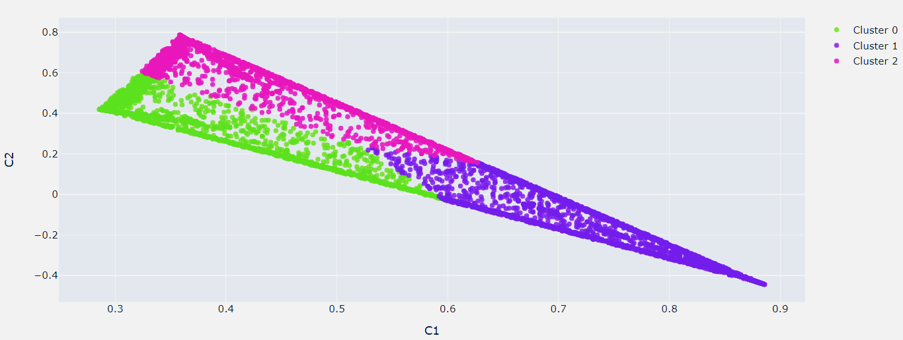
Topic Modelling
4
Visualizing Topic Clusters in 2D Using Truncated SVD

Slide 38
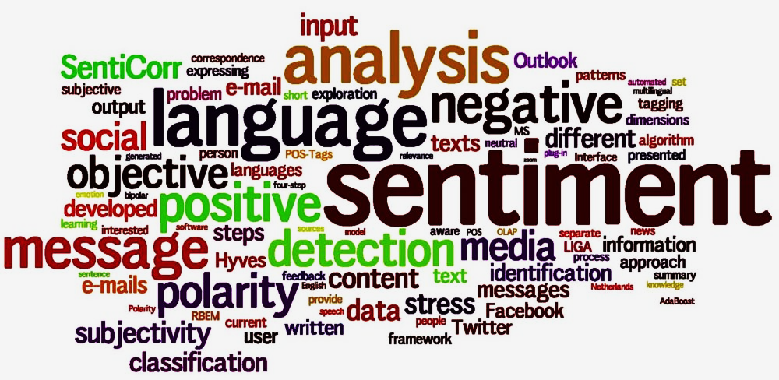
Sentiment Analysis
*
1
All the reviews, been with a rating of 3.5 or more labelled as Positive, all excepts are labelled as Negative
2
Pipeline Created with following steps Vectorization (CountVectorizer) → Cross Validation (ShuffleSplit, Halving grid search)
3
5 different models been trained following BernoulliNB, LinearSVC, Decision Tree Classifier, Logistic Regression & K-Nearest Neighbors.
*The following image is downloaded from internet and used for preview only and word cloud has no relation with our work

Slide 39
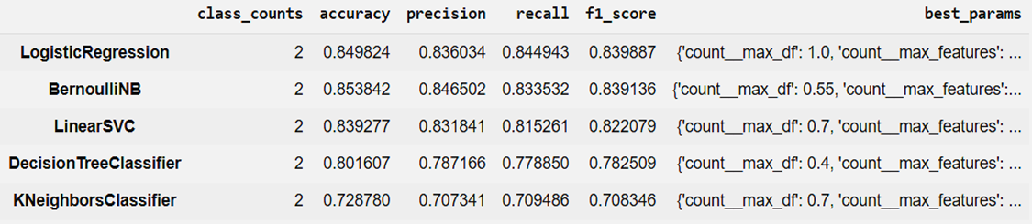
Sentiment Analysis
Ranks of Pipelines by F1 Score
Best performance achieved with Logistic Regression model with an f1 score of 0.84 and recall of 0.845.

Slide 40
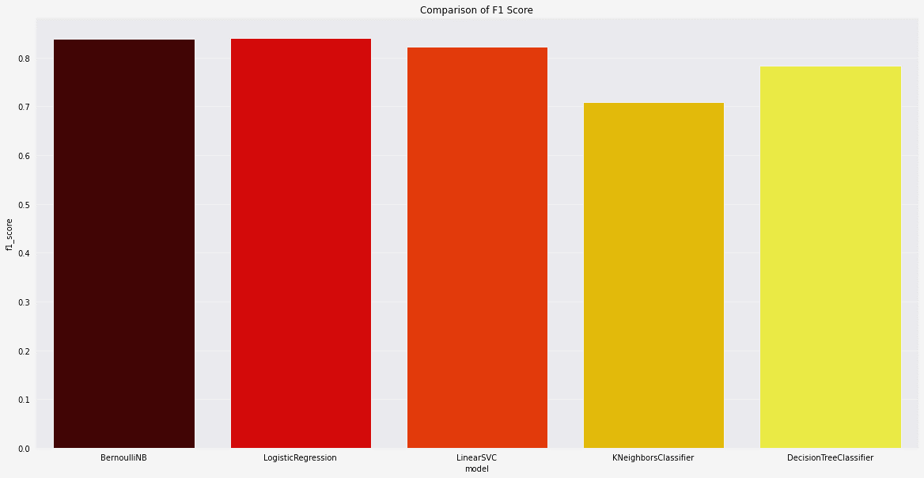
Sentiment Analysis
Comparison of F1 score
Best performance achieved with Logistic Regression model with an f1 score of 0.84 and recall of 0.845.

Slide 41

Sentiment Analysis
Final model has been built on Logistic Regression
CountVectorizer: max_df = 1 ; max_features = 10000
1
Evaluating Model Parameters & Performance Score
LinearSVC: penalty = l2 ; class_weight = balanced
max_iter = 100000 ; C = 0.1

Slide 42
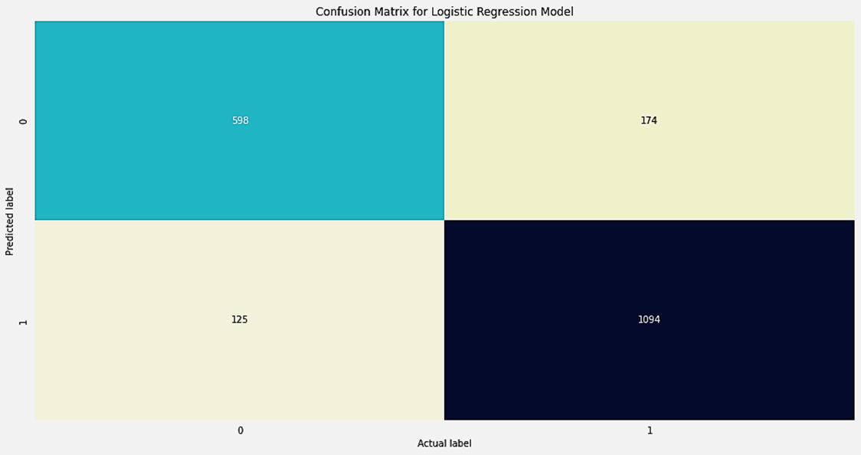
Sentiment Analysis
Final model has been built on Logistic Regression
1
Evaluating Model Parameters & Performance Score
2
Plot Confusion Matrix

Slide 43
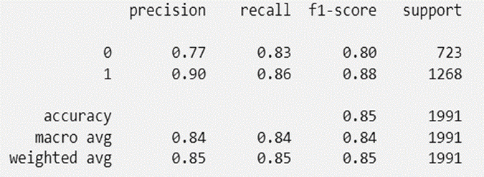
Sentiment Analysis
Final model has been built on Logistic Regression
1
Evaluating Model Parameters & Performance Score
2
Plot Confusion Matrix
3
Preview of Classification Report
Balanced Accuracy Score : 0.8449
Avg. Weighted F1 Score : 0.8508

Slide 44
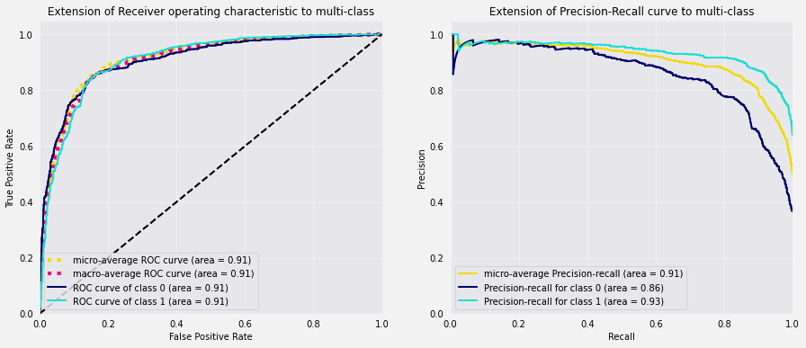
Sentiment Analysis
Final model has been built on Logistic Regression
1
Evaluating Model Parameters & Performance Score
2
Plot Confusion Matrix
3
Preview of Classification Report
4
Plot Extension of ROC Graph & Precision-Recall curve to multi-class

Slide 45
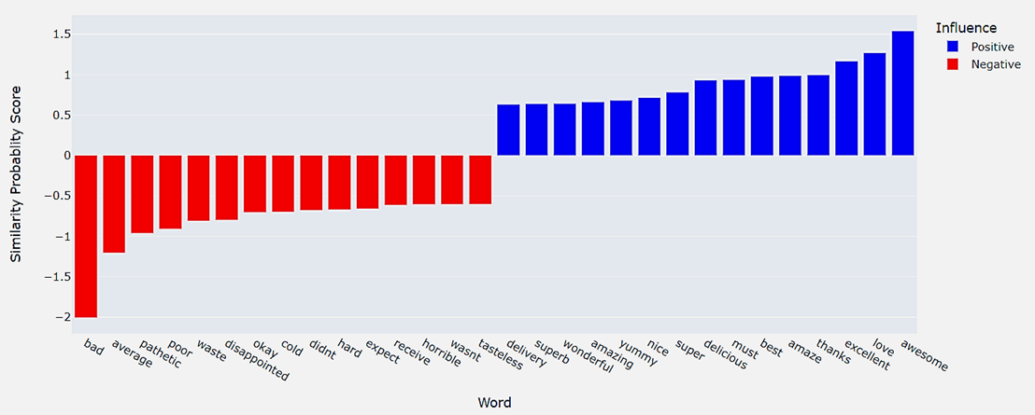
Sentiment Analysis
Final model has been built on Logistic Regression
1
Evaluating Model Parameters & Performance Score
2
Plot Confusion Matrix
3
Preview of Classification Report
4
Plot Extension of ROC Graph & Precision-Recall curve to multi-class
5
Top 15 Influential words

Slide 46

Limitations
1
Finding optimum number of clusters is purely a visual job and depends on one who analyzing. It’s very challenging and is keen prone to human error.
2
Our data contains very a smaller number of restaurants, as well as user reviews also contains a very limited set of vocabulary. These affects performing topic modelling and sentiment analysis too.

Slide 47

Future Scope & Improvements
1
We’ve grouped cuisines by demographical origin and availability. We can try to group cuisine by dish serve type or food type category. This manipulates the clusters most
2
We can try some other vectorization method like Inverse Document Term Frequency etc. Some advanced complex word embedding techniques can also be applied like Glove, doc2vec but those work greatly on larger document corpus, we don’t think with such limited data we’ve those complex methods could perform any better

Slide 48

Conclusion
1
Best optimum number of clusters we obtained is 4.
2
We’ve achieved 3 distinct topics as best component no for Topic Modelling
3
For Sentiment Analysis, Logistic Regression is the highest accurate model so far. Avg Weighted F1 score is 0.85 and the Area under ROC curve is 0.91 which is satisfactory.
4
Interesting fact, longer reviews have more chance of having a higher rating.

Slide 49


Thank You
Link to GitHub Project Repo
Link to Drive Project Folder
Link to Colab Notebook
As part of Supervised ML Classification Project by

